Slide 1

CSE 423
Virtualization and Cloud Computing
Lecture 12
Module III
Dr. Madhavi Dhingra

Slide 2
Contents
Service Level Agreement
Service Oriented Architecture
Capacity Planning

Slide 3
Service Level Agreement
A Service Level Agreement (SLA) is the bond for the performance of the negotiation between a cloud service provider and a client. Earlier, in cloud computing, all service level agreements were negotiated between a customer and a service consumer. With the introduction of large utilities such as cloud computing providers, most service level agreements are standardized until a customer becomes a large consumer of cloud services. Service level agreements are also defined at different levels, which are mentioned below:
Customer-based SLA
Service-based SLA
Multilevel SLA
Some service level agreements are enforceable as contracts, but most are agreements or contracts that are more in line with an operating level agreement (OLA) and may not be constrained by law. It's okay to have a lawyer review documents before making any major settlement with a cloud service provider.

Slide 4
Contd…
Service level agreements usually specify certain parameters, which are mentioned below:
Availability of the Service (uptime)
Latency or the response time
Service components reliability
Each party accountability
Warranties

Slide 5
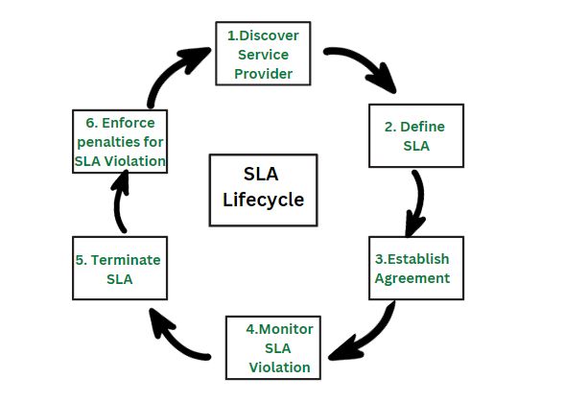
Steps in SLA Lifecycle

Slide 6
Steps in SLA Lifecycle
Discover service provider: This step involves identifying a service provider that can meet the needs of the organization and has the capability to provide the required service. This can be done through research, requesting proposals, or reaching out to vendors.
Define SLA: In this step, the service level requirements are defined and agreed upon between the service provider and the organization. This includes defining the service level objectives, metrics, and targets that will be used to measure the performance of the service provider.
Establish Agreement: After the service level requirements have been defined, an agreement is established between the organization and the service provider outlining the terms and conditions of the service. This agreement should include the SLA, any penalties for non-compliance, and the process for monitoring and reporting on the service level objectives.
Monitor SLA violation: This step involves regularly monitoring the service level objectives to ensure that the service provider is meeting their commitments. If any violations are identified, they should be reported and addressed in a timely manner.
Terminate SLA: If the service provider is unable to meet the service level objectives, or if the organization is not satisfied with the service provided, the SLA can be terminated. This can be done through mutual agreement or through the enforcement of penalties for non-compliance.
Enforce penalties for SLA Violation: If the service provider is found to be in violation of the SLA, penalties can be imposed as outlined in the agreement. These penalties can include financial penalties, reduced service level objectives, or termination of the agreement.

Slide 7
Advantages
Improved communication: A better framework for communication between the service provider and the client is established through SLAs, which explicitly outline the degree of service that a customer may anticipate. This can make sure that everyone is talking about the same things when it comes to service expectations.
Increased accountability: SLAs give customers a way to hold service providers accountable if their services fall short of the agreed-upon standard. They also hold service providers responsible for delivering a specific level of service.
Better alignment with business goals: SLAs make sure that the service being given is in line with the goals of the client by laying down the performance goals and service level requirements that the service provider must satisfy.
Reduced downtime: SLAs can help to limit the effects of service disruptions by creating explicit protocols for issue management and resolution.
Better cost management: By specifying the level of service that the customer can anticipate and providing a way to track and evaluate performance, SLAs can help to limit costs. Making sure the consumer is getting the best value for their money can be made easier by doing this.

Slide 8
Disadvantages
Complexity: SLAs can be complex to create and maintain, and may require significant resources to implement and enforce.
Rigidity: SLAs can be rigid and may not be flexible enough to accommodate changing business needs or service requirements.
Limited service options: SLAs can limit the service options available to the customer, as the service provider may only be able to offer the specific services outlined in the agreement.
Misaligned incentives: SLAs may misalign incentives between the service provider and the customer, as the provider may focus on meeting the agreed-upon service levels rather than on providing the best service possible.
Limited liability: SLAs are not legal binding contracts and often limited the liability of the service provider in case of service failure.

Slide 9
Example of SLA by SQL Azure
SQL Azure SLA – SQL Azure clients will have connectivity between the database and internet gateway of SQL Azure. SQL Azure will handle a “Monthly Availability” of 99.9% within a month. Monthly Availability Proportion for a particular tenant database is the ratio of the time the database was available to customers to the total time in a month. Time is measured in some intervals of minutes in a 30-day monthly cycle. Availability is always remunerated for a complete month. A portion of time is marked as unavailable if the customer’s attempts to connect to a database are denied by the SQL Azure gateway.

Slide 10
Service Oriented Architecture
Service-Oriented Architecture (SOA) is a stage in the evolution of application development and/or integration. It defines a way to make software components reusable using the interfaces.
Formally, SOA is an architectural approach in which applications make use of services available in the network. In this architecture, services are provided to form applications, through a network call over the internet. It uses common communication standards to speed up and streamline the service integrations in applications. Each service in SOA is a complete business function in itself. The services are published in such a way that it makes it easy for the developers to assemble their apps using those services.

Slide 11
Contd…
There are two major roles within Service-oriented Architecture:
Service provider: The service provider is the maintainer of the service and the organization that makes available one or more services for others to use. To advertise services, the provider can publish them in a registry, together with a service contract that specifies the nature of the service, how to use it, the requirements for the service, and the fees charged.
Service consumer: The service consumer can locate the service metadata in the registry and develop the required client components to bind and use the service.

Slide 12
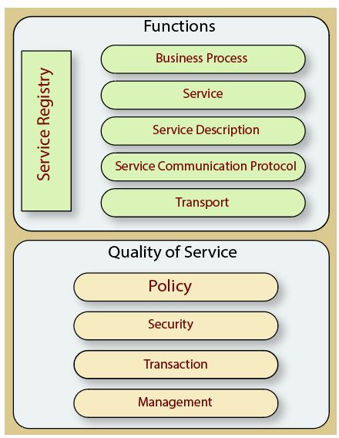
Functional aspects
The functional aspect contains:
Transport - It transports the service requests from the service consumer to the service provider and service responses from the service provider to the service consumer.
Service Communication Protocol - It allows the service provider and the service consumer to communicate with each other.
Service Description - It describes the service and data required to invoke it.
Service - It is an actual service.
Business Process - It represents the group of services called in a particular sequence associated with the particular rules to meet the business requirements.
Service Registry - It contains the description of data which is used by service providers to publish their services.
Quality of Service aspects
The quality of service aspects contains:
Policy - It represents the set of protocols according to which a service provider make and provide the services to consumers.
Security - It represents the set of protocols required for identification and authorization.
Transaction - It provides the surety of consistent result. This means, if we use the group of services to complete a business function, either all must complete or none of the complete.
Management - It defines the set of attributes used to manage the services.
Components of service-oriented architecture

Slide 13
Guiding Principles of SOA
Standardized service contract: Specified through one or more service description documents.
Loose coupling: Services are designed as self-contained components, maintain relationships that minimize dependencies on other services.
Abstraction: A service is completely defined by service contracts and description documents. They hide their logic, which is encapsulated within their implementation.
Reusability: Designed as components, services can be reused more effectively, thus reducing development time and the associated costs.
Autonomy: Services have control over the logic they encapsulate and, from a service consumer point of view, there is no need to know about their implementation.
Discoverability: Services are defined by description documents that constitute supplemental metadata through which they can be effectively discovered. Service discovery provides an effective means for utilizing third-party resources.
Composability: Using services as building blocks, sophisticated and complex operations can be implemented. Service orchestration and choreography provide a solid support for composing services and achieving business goals.

Slide 14
Advantages of SOA
Service reusability: In SOA, applications are made from existing services. Thus, services can be reused to make many applications.
Easy maintenance: As services are independent of each other they can be updated and modified easily without affecting other services.
Platform independent: SOA allows making a complex application by combining services picked from different sources, independent of the platform.
Availability: SOA facilities are easily available to anyone on request.
Reliability: SOA applications are more reliable because it is easy to debug small services rather than huge codes
Scalability: Services can run on different servers within an environment, this increases scalability

Slide 15
Disadvantages of SOA
High overhead: A validation of input parameters of services is done whenever services interact this decreases performance as it increases load and response time.
High investment: A huge initial investment is required for SOA.
Complex service management: When services interact they exchange messages to tasks. the number of messages may go in millions. It becomes a cumbersome task to handle a large number of messages.

Slide 16
Practical applications of SOA
SOA infrastructure is used by many armies and air forces to deploy situational awareness systems.
SOA is used to improve healthcare delivery.
Nowadays many apps are games and they use inbuilt functions to run. For example, an app might need GPS so it uses the inbuilt GPS functions of the device. This is SOA in mobile solutions.
SOA helps maintain museums a virtualized storage pool for their information and content.

Slide 17
Capacity Planning
For available resources, capacity planning seeks a heavy demand. It determines whether the systems are working properly, used to measure their performance, determine the usage of patterns and predict future demand of cloud-capacity. This also adds an expertise planning for improvement and optimizes performance. The goal of capacity planning is to maintain the workload without improving the efficiency. Tuning of performance and work optimization is not the major target of capacity planners.
Determine the distinctiveness of the present system.
Determine the working load for different resources in the system such as CPU, RAM, network, etc.
Load the system until it gets overloaded; & state what's requiring to uphold acceptable performance.
Predict the future based on older statistical reports & other factors.
Deploy resources to meet the predictions & calculations.
Repeat step (i) through (v) as a loop.

Slide 18
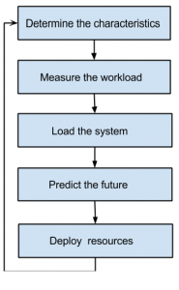
Benefits of Cloud Capacity Planning
Reduction of Costs
A strategic cloud capacity plan helps IT anticipate and plan for changes that may affect cloud resource management. Your IT team can better control, track, and adjust resource capacity, consumption, and related budgets or quotas when they understand business priorities and plans.
Application Performance
Poor performance can lead to negative user experiences and increased customer churn. As part of strategic cloud capacity planning, IT can find and fix performance bottlenecks from systems and applications. Additionally, cloud capacity planning helps you find cost-effective ways to achieve optimal performance.
Agility
Your IT team can effectively plan for unforeseen spikes in demand using historical data and usage patterns as part of effective cloud capacity planning.

